Slide 1
CLASS 2 - SOLANA INDIA BOOTCAMP
RUST ADVANCE

Slide 2
Topics
Box
Deref
Rc
RefCell
Arc
Mutex
mpsc

Slide 3
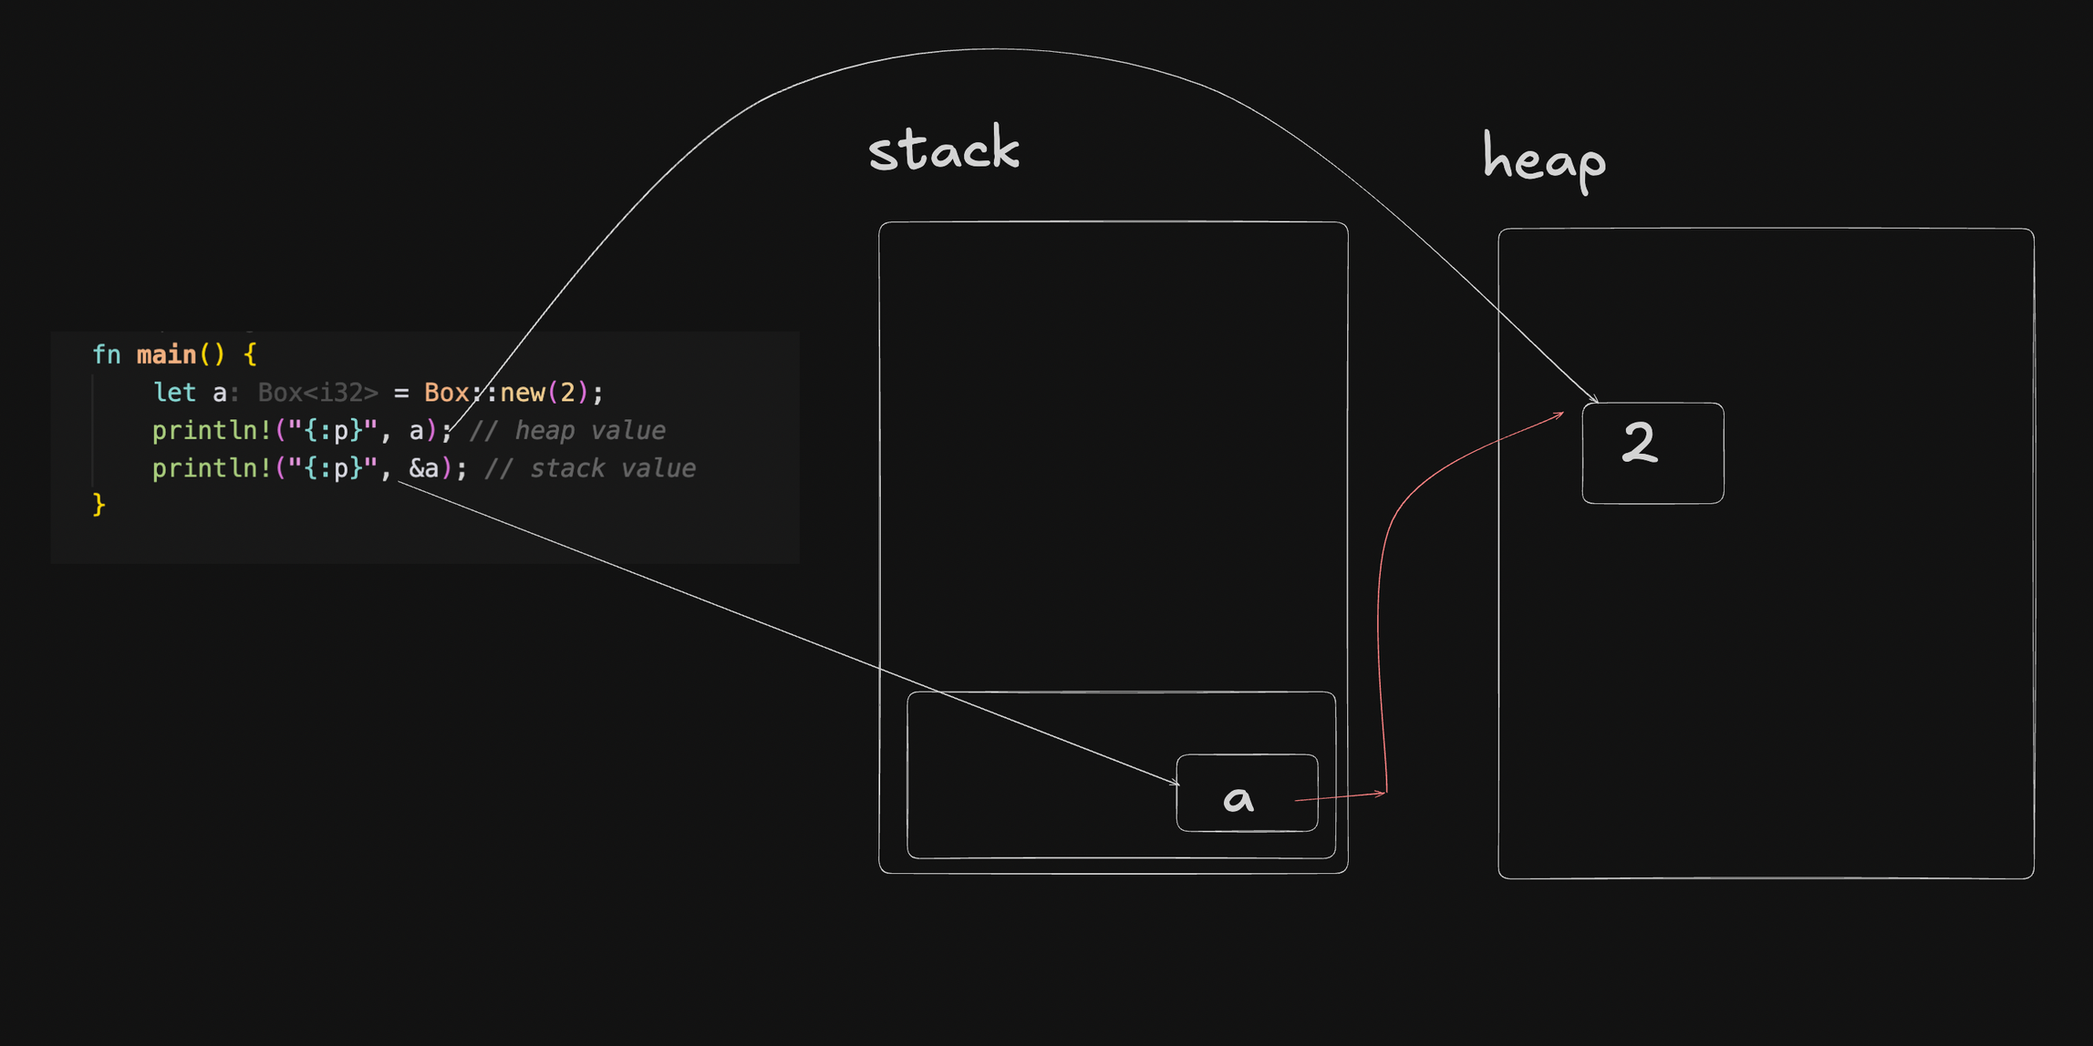
Box

Slide 4
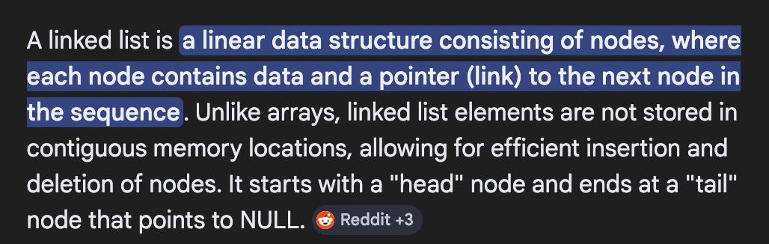
Box
Q - How would you build a linked list in rust?

Slide 5
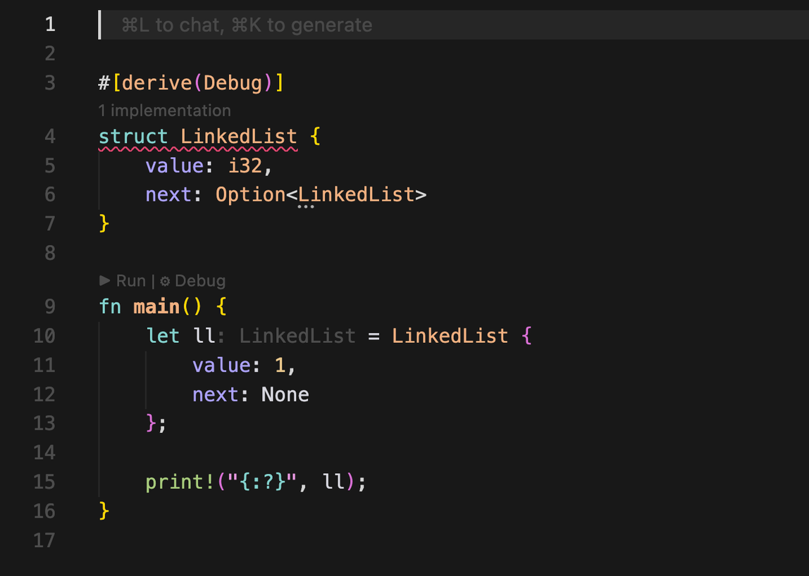
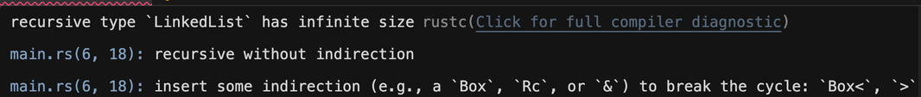
Box
Q - How would you build a linked list in rust?

Slide 6
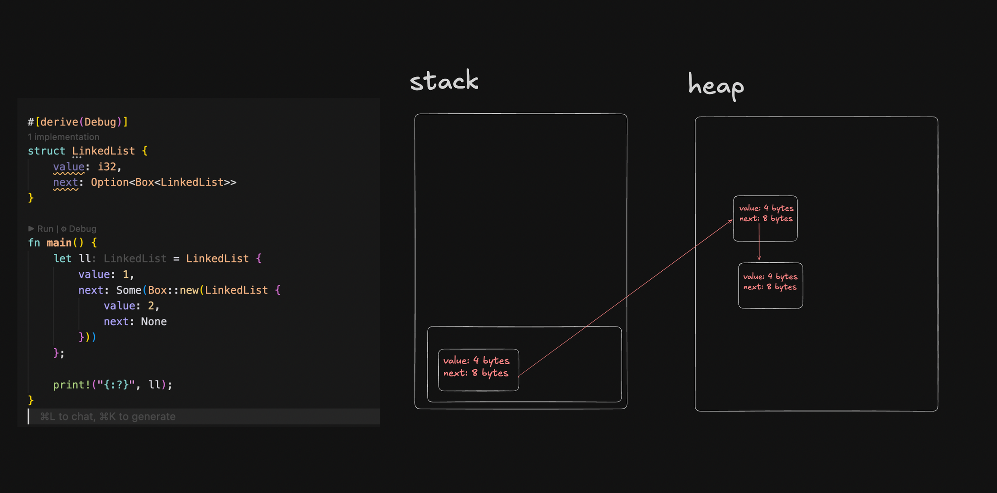
Box
Q - How would you build a linked list in rust?

Slide 7
Topics
Box
Deref
Rc
RefCell
Arc
Mutex
mpsc
✅

Slide 8
Deref
The Deref trait lets you control what happens when you use the * operator on a type. Rust uses deref coercion to automatically convert &Box to &T, making smart pointers ergonomic.

Slide 9
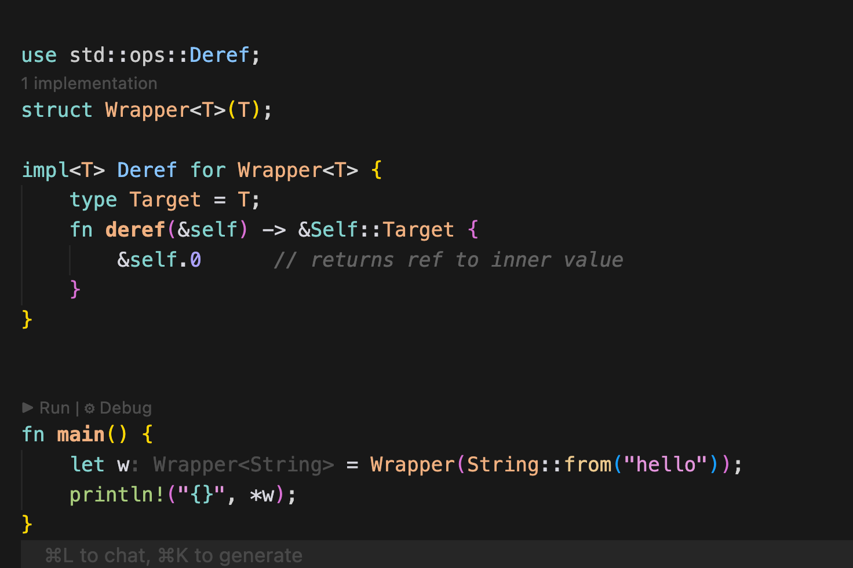
Deref (1. wrapper structs)

Slide 10
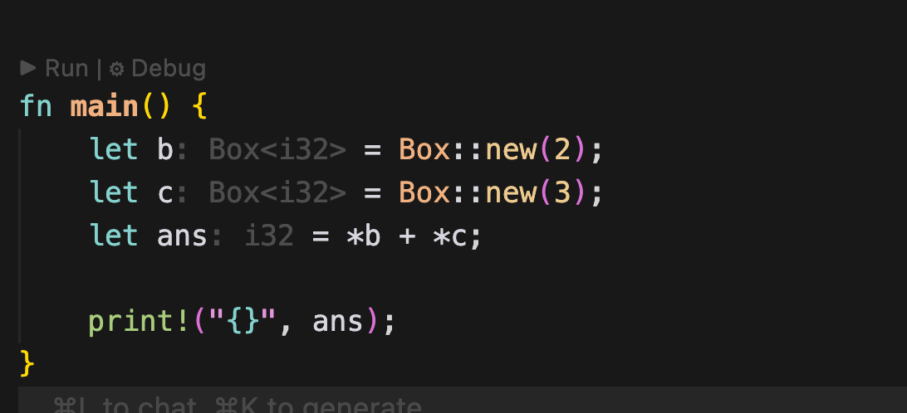
Deref (2. Box deref coersion)

Slide 11
Topics
Box
Deref
Rc
RefCell
Arc
Mutex
mpsc
✅
✅

Slide 12
Rc (reference counting)
Rc (Reference Counted) allows multiple parts of your program to own the same data. The data is kept alive as long as any Rc pointing to it exists. Single-threaded only.

Slide 13
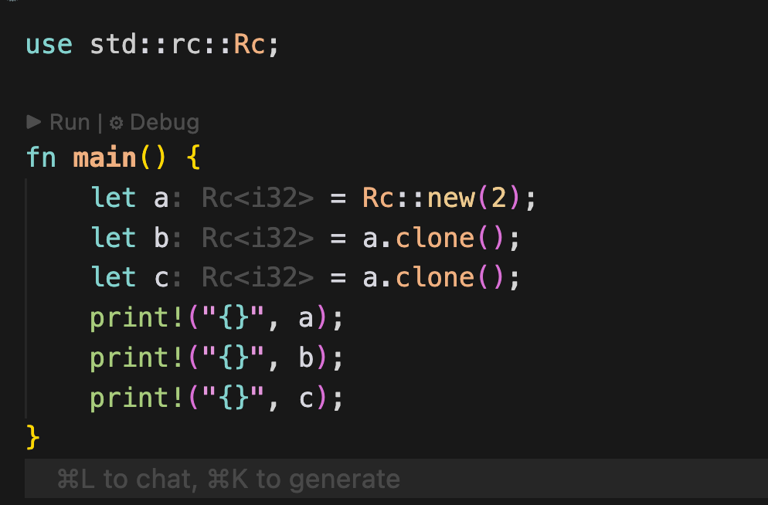
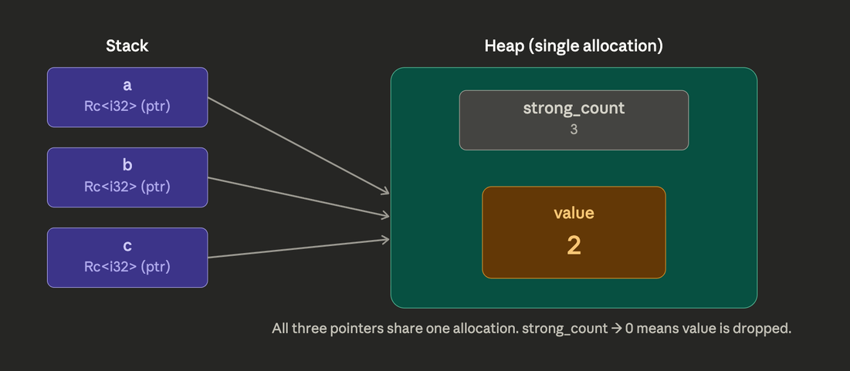
Rc (reference counting)

Slide 14
Topics
Box
Deref
Rc
RefCell
Arc
Mutex
mpsc
✅
✅
✅

Slide 15
RefCell
RefCell moves borrow checking from compile time to runtime. It lets you hold mutable references even in contexts where the borrow checker would normally refuse — at the cost of a potential panic.

Slide 16
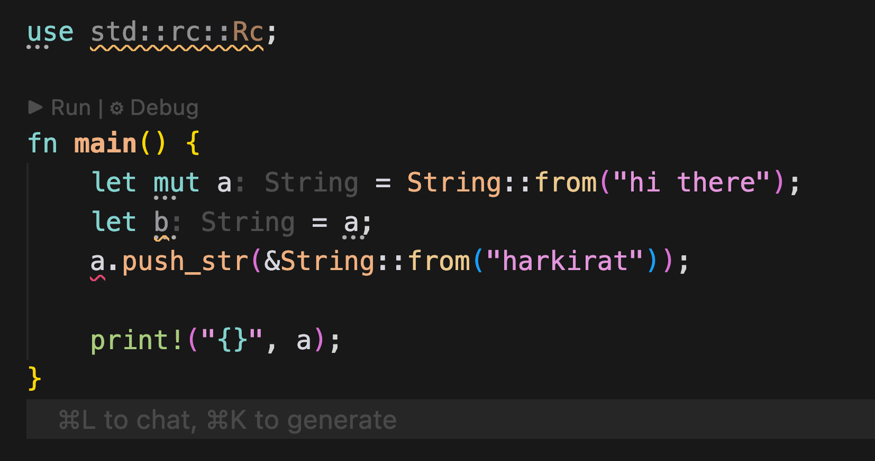
RefCell
What is the issue here?

Slide 17
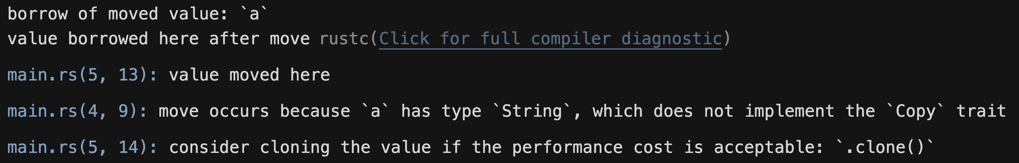
RefCell
What is the issue here?
Borrow checker complains
RefCell moves borrow checking from compile time to runtime.

Slide 18
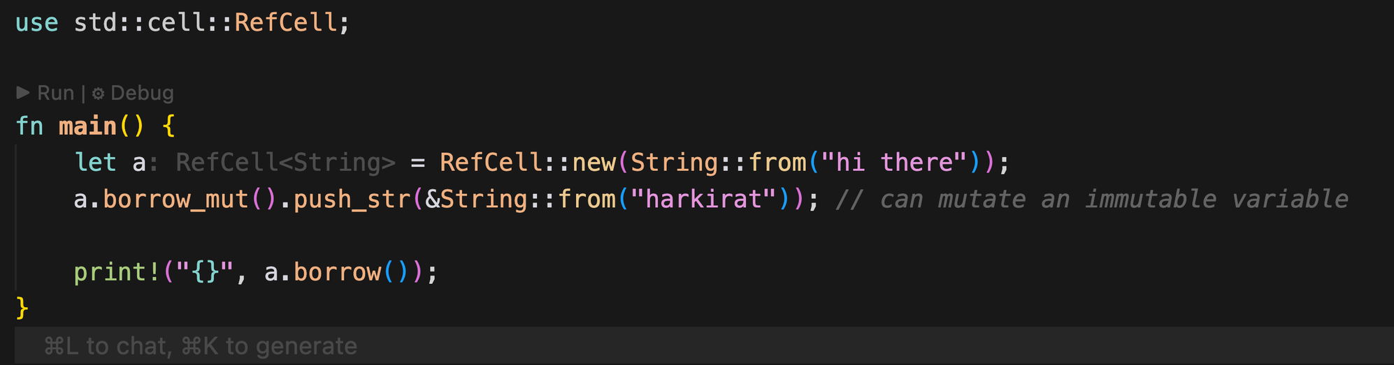
RefCell (Use case 1 - interior mutability)

Slide 19
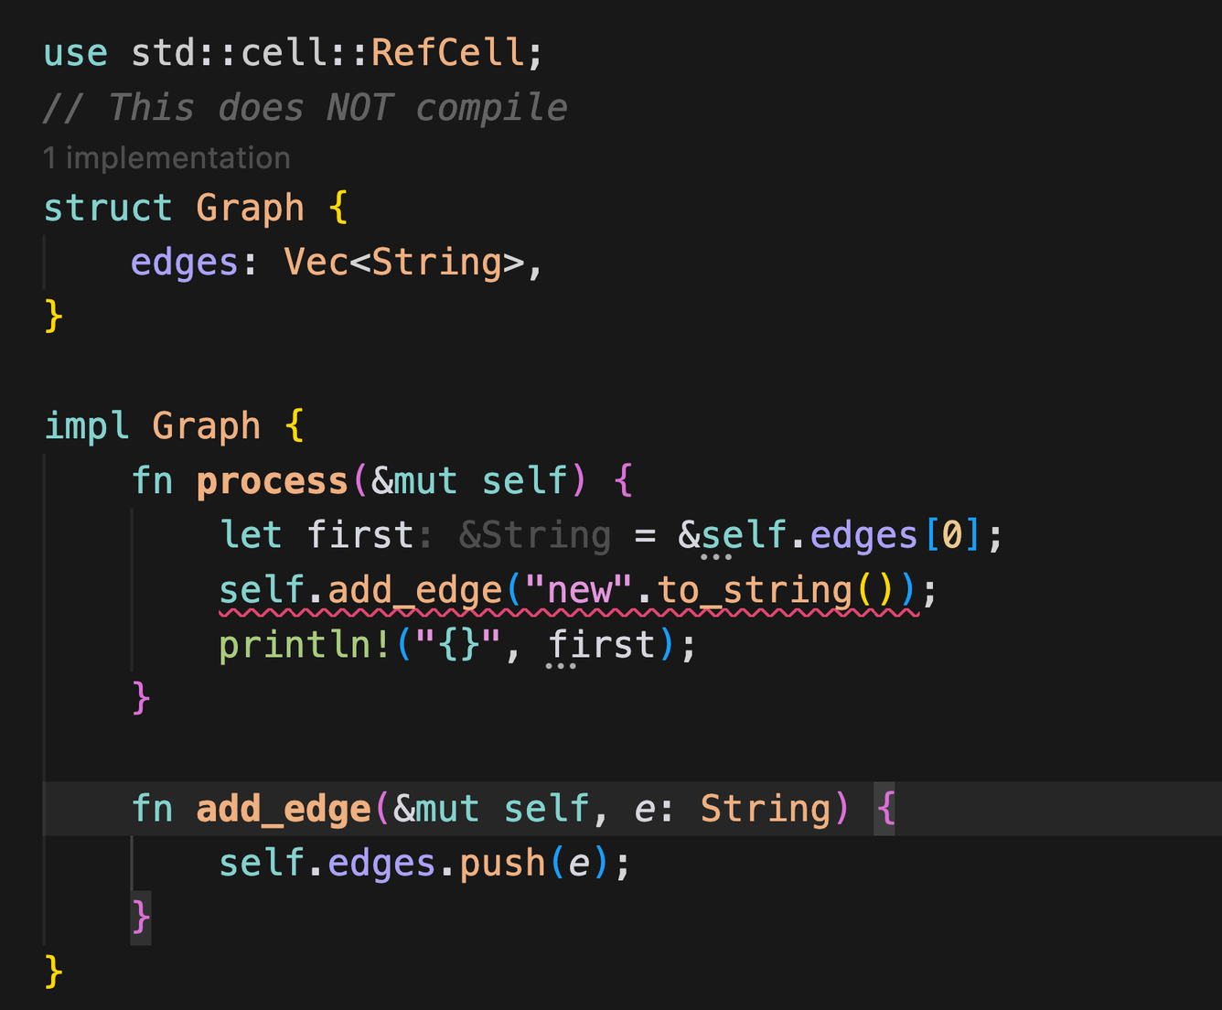
RefCell (Use case 2)
Whats the error?

Slide 20
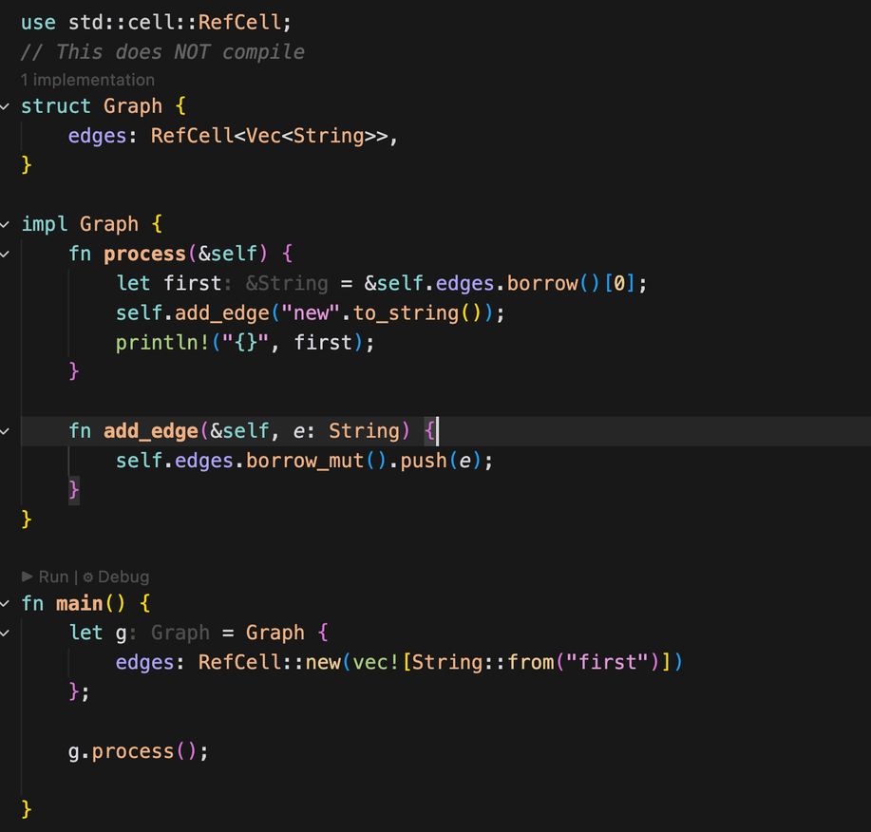
RefCell (Use case 2)

Slide 21
RefCell (Use case 2)
Q1 - Will this compile?

Slide 22
RefCell (Use case 2)
Q1 - Will this compile? - yes

Slide 23
RefCell (Use case 2)
Q2 - Will this run?

Slide 24
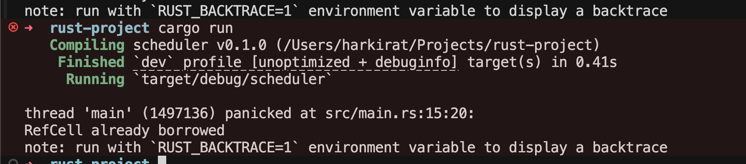
RefCell (Use case 2)
Q2 - Will this run?

Slide 25
So whats the point of refcell?
It just moved the error from compile time to runtime. What benefit does it provide?

Slide 26
So whats the point of refcell?
– none really. it lets you write code in a way that would’ve failed during compilation but might succeed during runtime
There is certain code you cant write/wont compile w/o using Rc + RefCell
The real benefit comes with Rc and RefCel are used together.

Slide 27
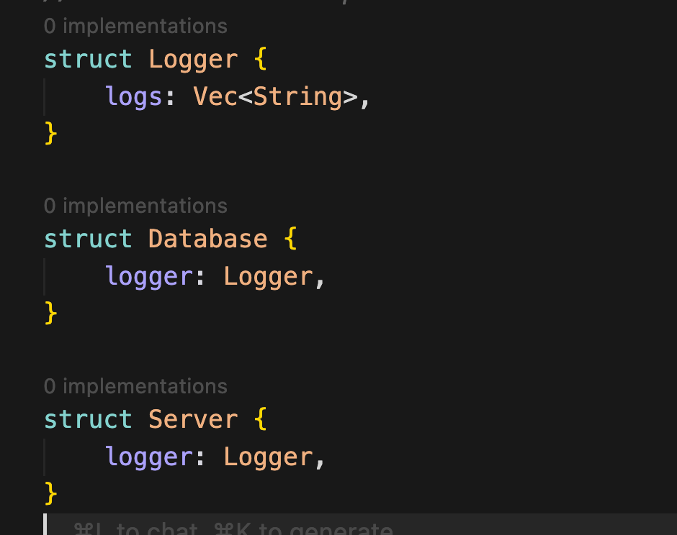
Q: You have a Logger that both a Database and a Server component hold. When either logs something, the other should see it when they read the log.

Slide 28
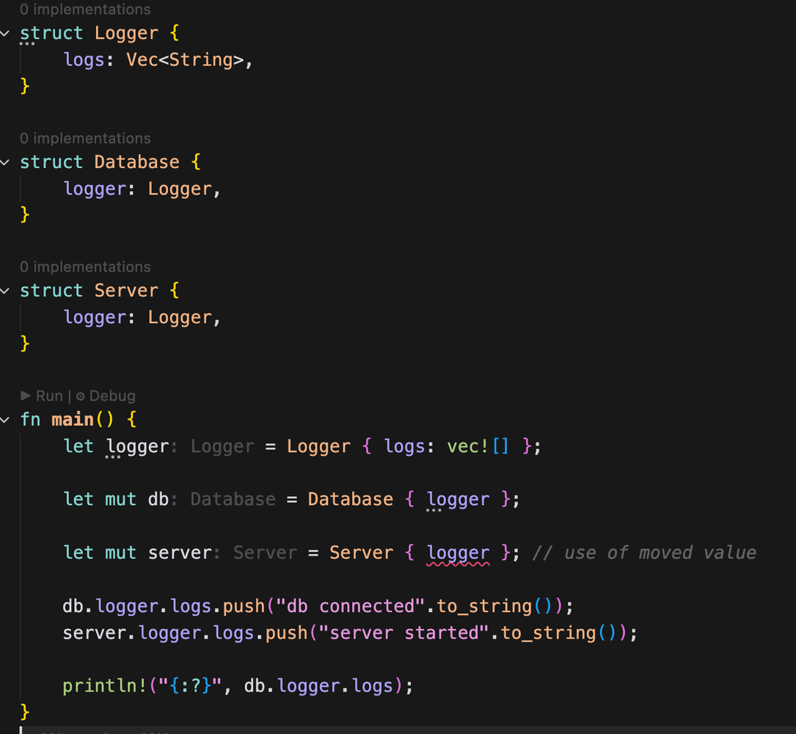
Q: You have a Logger that both a Database and a Server component hold. When either logs something, the other should see it when they read the log.

Slide 29
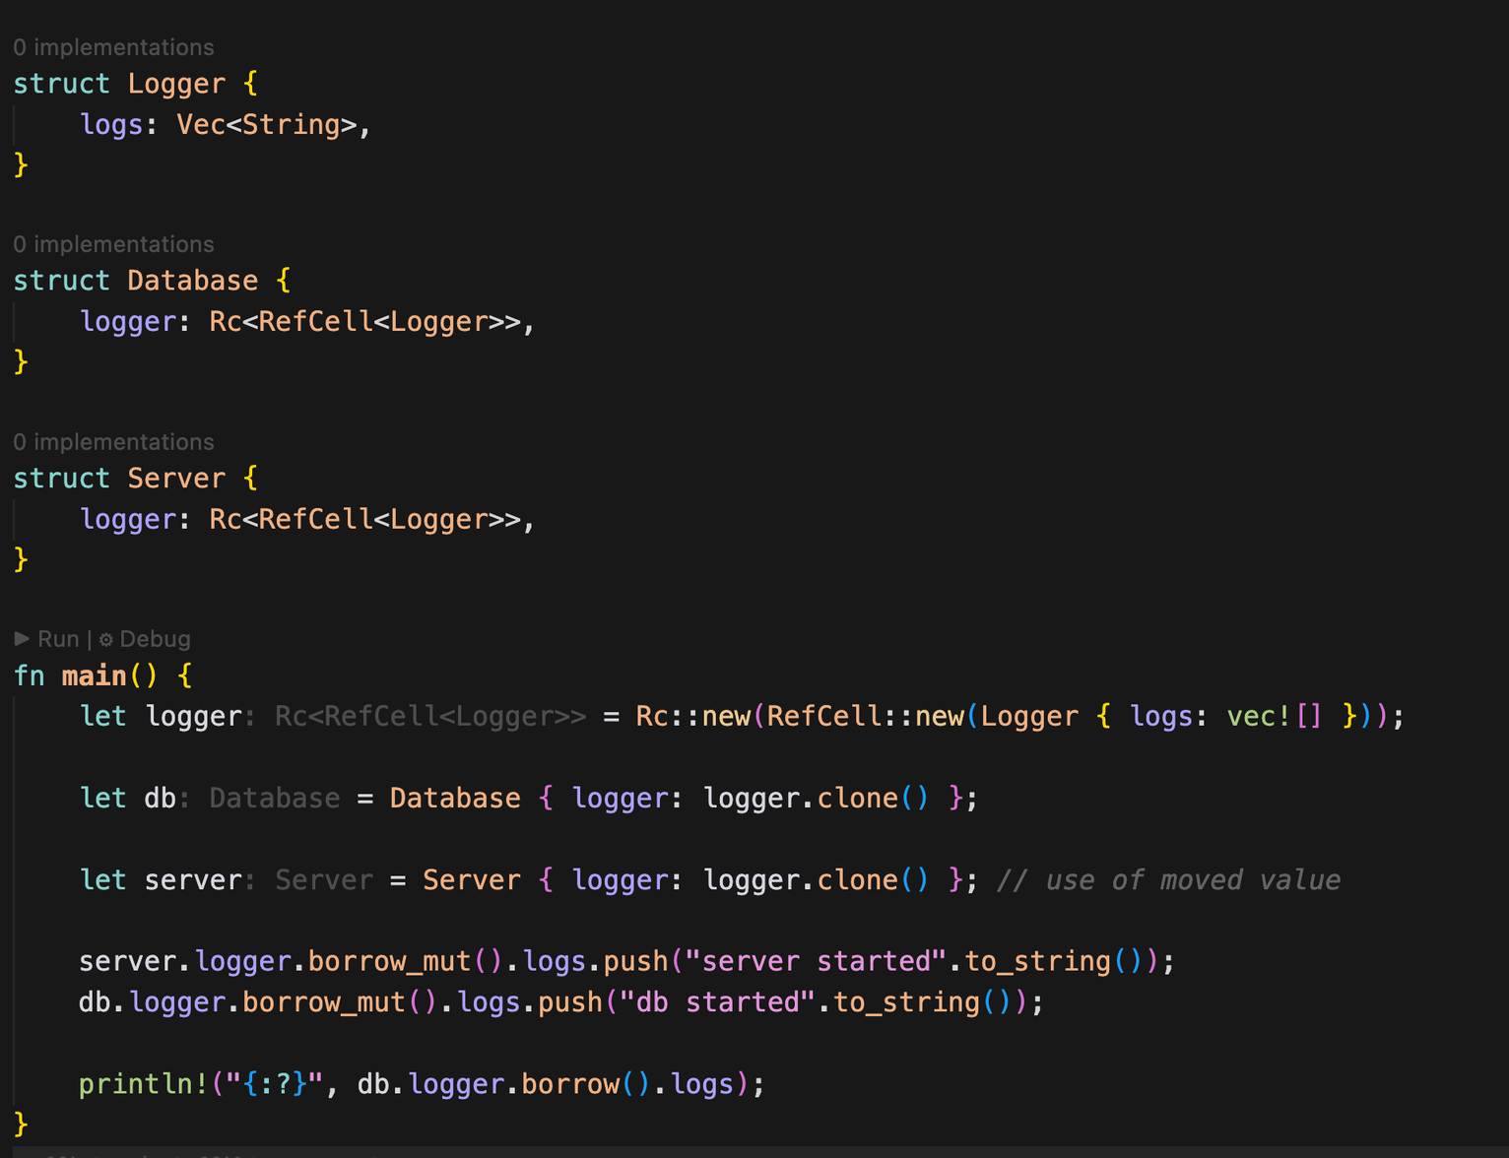
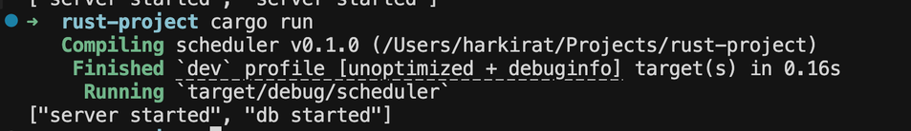
Solution

Slide 30
Q1 - Arent there two mutable
borrows here?
Shouldnt that panic at runtime?

Slide 31
Q1 - Arent there two mutable
borrows here?
Shouldnt that panic at runtime?
Ans - First mutable borrow drops right
after the line

Slide 32
Q2 - Why both Rc and Refcell
are needed?

Slide 33
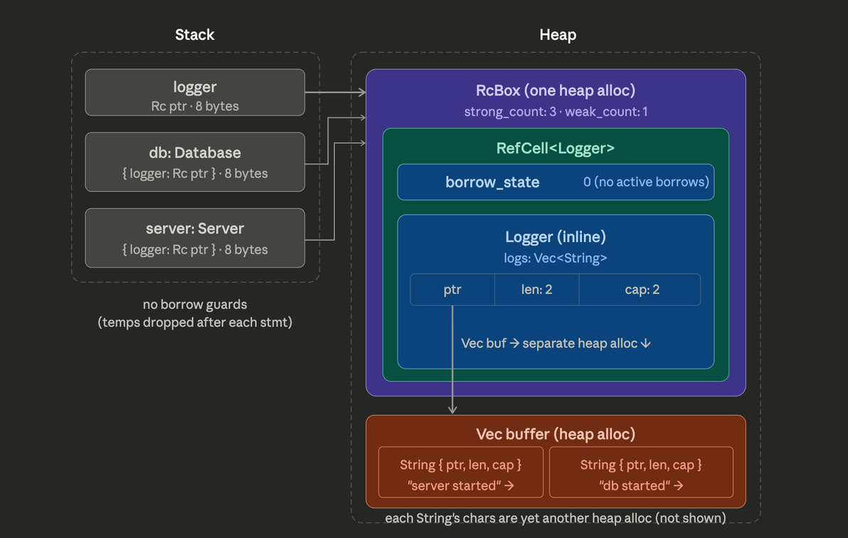
Q2 - Why both Rc and Refcell
are needed?
Rc is for multiple owners
Refcell is for interior mutability

Slide 34
Topics
Box
Deref
Rc
RefCell
Arc
Mutex
mpsc
✅
✅
✅
✅
Multithreaded memory management
Super 30 2.0 has a live class on it that we will post

